Slide 1


Analysis of Amazon Sales
This business intelligence project aims to provide a comprehensive analysis of Amazon sales data, uncovering valuable insights to optimize inventory and sales strategies. By leveraging the wealth of information available in the Amazon sales dataset, we will explore sales trends, identify high-performing products, and uncover customer preferences to help drive informed decision-making for the business.
Realized by: Farouk daboussi, Alia sakkli, Siwar kouki and yassine

Slide 2

Data Collection and Cleaning
1
Data Sources
The data for this project was collected from the Amazon sales dataset available on Kaggle, covering sales transactions, product information, and shipping details from 2012 to 2015.
2
Data Cleaning
The data was thoroughly cleaned to address missing values, remove duplicates, and ensure data integrity. The cleaning process involved handling various data quality issues and implementing effective solutions to prepare the data for further analysis.
3
Challenges and Solutions
During the data cleaning phase, we encountered challenges such as inconsistent data formats and the need to standardize product categories. By employing advanced data processing techniques and collaborating with subject matter experts, we were able to overcome these obstacles and create a clean and reliable dataset for the analysis.

Slide 3
Feature Engineering
Feature Selection
New Features
Feature Importance
The key features selected for this analysis include Order_ID, Order_Date, Ship_Date, Ship_Mode, Customer_ID, Customer_Name, Segment, City, State, Country, Region, Market, Product_ID, Category, Sub_Category, Product_Name, Sales, Quantity, Discount, Profit, Shipping_Cost, and Order_Priority. These features provide a comprehensive view of the sales transactions, customer information, and product details necessary for the analysis.
To further enhance the analysis, we engineered several new features, such as Customer_Sex (derived from customer name), Purchase Count Group, Average Lifespan, Customer Lifetime Value (CLV), Publishing Frequency, and Average Order Value (AOV). These additional features help uncover deeper insights into customer behavior, sales patterns, and product performance.
The selected and engineered features are crucial for this analysis as they enable us to understand sales trends, optimize inventory management, and develop targeted marketing strategies. By leveraging these features, we can gain valuable insights into customer preferences, high-performing products, and the overall dynamics of the Amazon sales ecosystem.

Slide 4
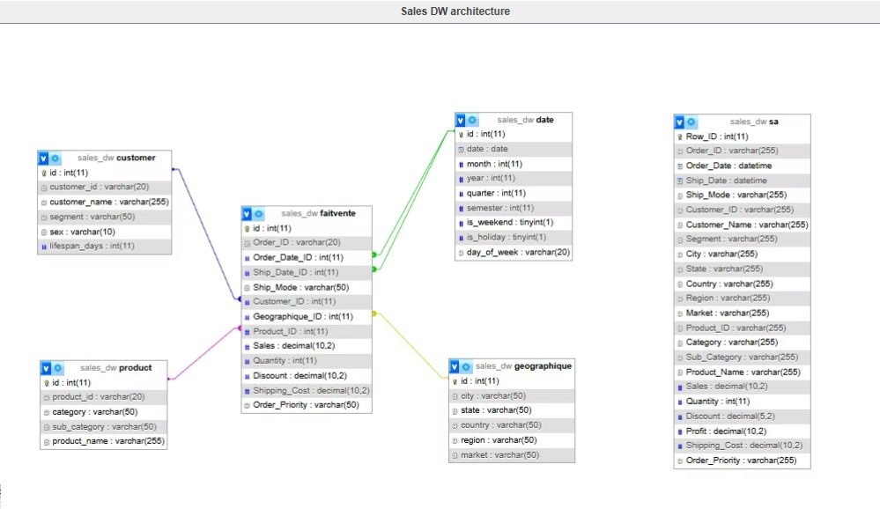
Data Warehousing
Data Warehouse Design
ETL Process
Updating Mechanism
The Extract, Transform, and Load (ETL) process is a crucial step in populating the data warehouse. We employ a robust ETL pipeline to ensure data quality, consistency, and reliability. This includes data validation, transformation, and the use of the Batch method to guarantee the successful and complete loading of data into the warehouse, with a rollback mechanism to revert to the previous state if any issues arise.
To keep the data warehouse up-to-date, we have implemented a comprehensive updating mechanism. This process involves scanning the incoming data, verifying compatibility and quality, and then detecting new records. The ETL script is then executed to seamlessly update the data warehouse, ensuring that the information remains current and reflective of the latest sales activities.
The data warehouse for this project follows a star schema design, with dimensions for Customers, Products, Geography, and Dates, and a fact table for Sales Transactions. This structure allows for efficient data storage, retrieval, and analysis, enabling us to quickly answer complex business queries and generate insightful reports.

Slide 5
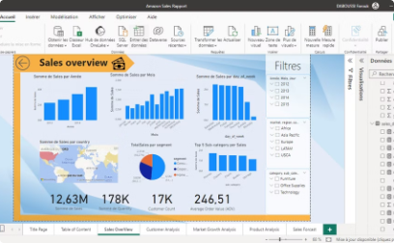
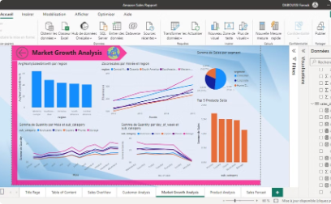
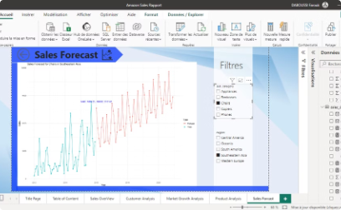
Reporting with Power BI
Dashboard Overview
Key Reports and Visualizations
Advanced Analytics
The Power BI dashboard provides a comprehensive view of the Amazon sales data, enabling stakeholders to quickly and effectively analyze the insights derived from the project. The dashboard includes a range of interactive visualizations and reports that allow for in-depth exploration of sales trends, top-performing products, and customer behavior.
The Power BI dashboard also incorporates advanced analytics capabilities, such as predictive modeling and forecasting. These features allow the team to anticipate future sales patterns, identify potential risks, and make data-driven decisions to drive the business forward.
The dashboard features a variety of reports and visualizations, including sales trends by product category, top-selling items, customer segmentation analysis, and targeted marketing insights. These reports enable decision-makers to identify growth opportunities, optimize inventory management, and develop effective sales and marketing strategies.

Slide 6

Insights and Analysis
1
Key Findings
The analysis of the Amazon sales data has yielded several key insights, including identifying peak sales periods, high-demand product categories, and shifts in customer purchasing behavior. These findings provide valuable information to help the business optimize inventory management, target marketing efforts, and capitalize on emerging trends.
2
Business Implications
The insights gained from this project can be leveraged to make informed, data-driven decisions that drive the business forward. By understanding sales patterns, customer preferences, and market dynamics, the leadership team can develop strategies to improve profitability, enhance customer satisfaction, and maintain a competitive edge in the e-commerce landscape.
3
Actionable Recommendations
Based on the analysis, we have generated a set of actionable recommendations to help the business optimize its sales and inventory management strategies. These include adjusting product assortment, refining pricing and promotional strategies, and implementing targeted marketing campaigns to reach and retain high-value customers.

Slide 7




Challenges and Lessons Learned
Measure Creation with DAX
One of the key challenges we faced was the development of complex measures using DAX (Data Analysis Expressions) in Power BI. This required a deep understanding of the data model and the ability to create custom calculations to support the desired analyses and visualizations.
Implementing Reactive Plots
Another challenge was the implementation of reactive and dynamic data visualizations, such as those coded with R. This involved integrating the R-based visualizations seamlessly into the Power BI dashboard, ensuring a cohesive and responsive user experience.
Warehouse Updating Process
Ensuring the data warehouse remained up-to-date and accurate was also a critical challenge. We addressed this by implementing a robust updating mechanism that included data validation, compatibility checks, and a reliable rollback process to maintain the integrity of the data.

Slide 8




Conclusion
Summary
This business intelligence project has provided valuable insights into the Amazon sales ecosystem, enabling the leadership team to make informed decisions and drive the business forward. By leveraging the power of data analysis and visualization, we have uncovered key trends, identified high-performing products, and gained a deeper understanding of customer behavior.
Future Work
As we move forward, we plan to expand the scope of this project, exploring additional data sources, enhancing the predictive capabilities of the analytics, and incorporating machine learning techniques to further optimize sales and inventory strategies. By continuously innovating and adapting to the evolving e-commerce landscape, we are committed to delivering sustained growth and success for the business.
Q&A
We welcome any questions or feedback from the audience, as this will help us refine and improve the project's scope and impact. We are committed to fostering a collaborative environment and are eager to address any concerns or explore new ideas that can further enhance the value of this business intelligence initiative.

